Slide 1

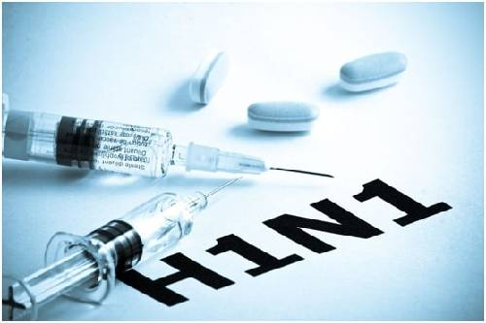

FLU VACCINE PREDICTION: A TOOL FOR IMPROVING PUBLIC HEALTH
by collins chumba

Slide 2
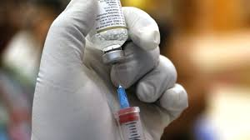
Contents
01
Introduction
02
Project Goals
03
Data Overview
04
Methods
05
Results
06
Future Goals
07
Connecting with Stakeholder Needs

Slide 3


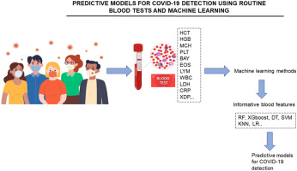
Introduction
My predictive analysis project aimed at improving vaccination rates during flu outbreaks, specifically focusing on the H1N1 flu vaccine. Our project addresses the pressing need to enhance public health strategies to combat infectious diseases effectively.

Slide 4
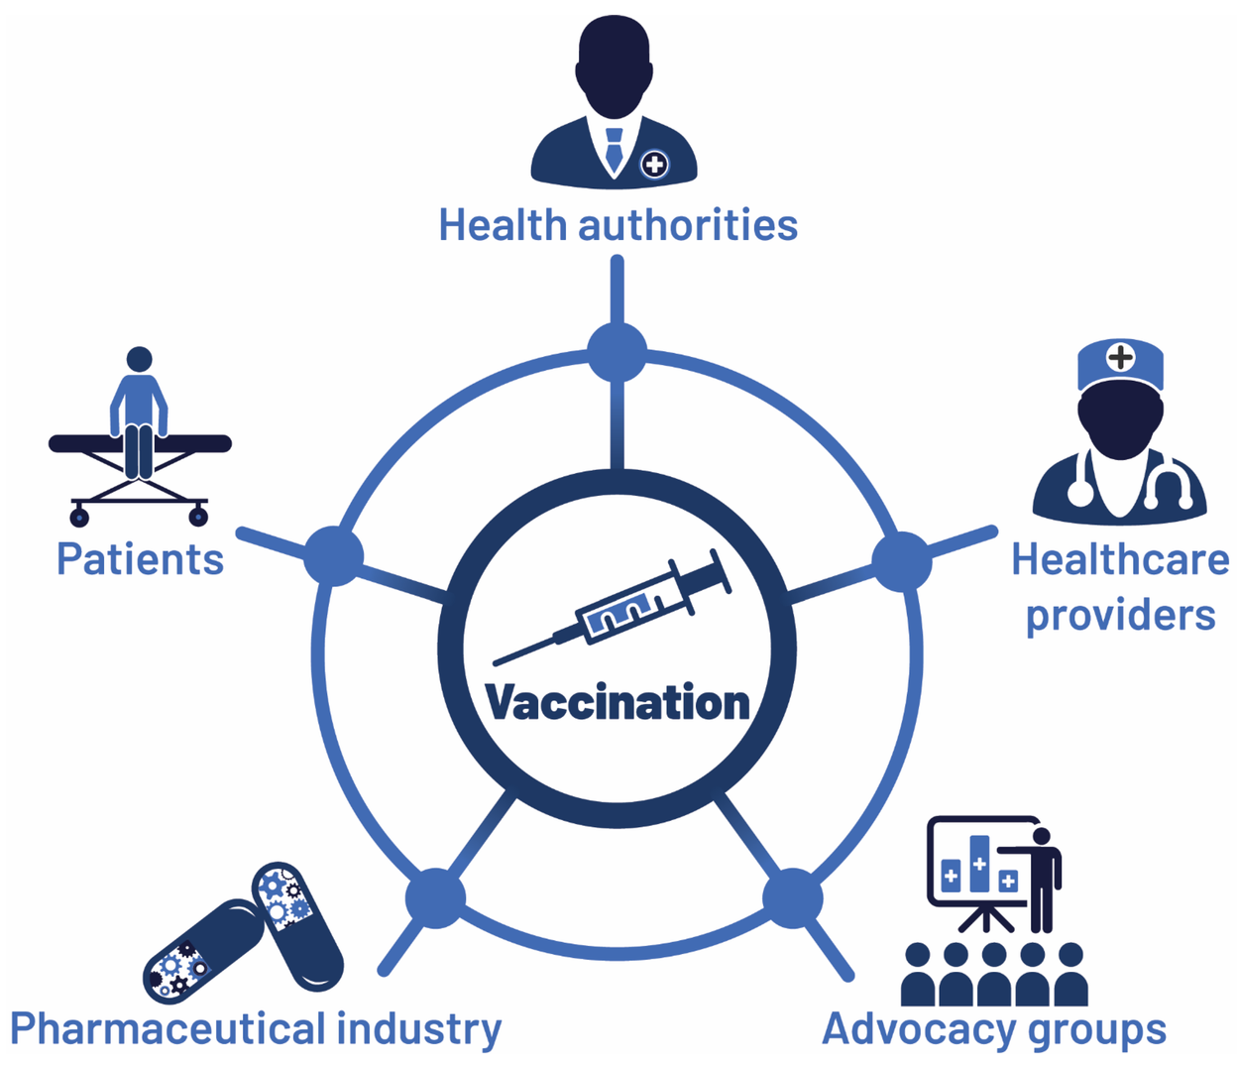

Project Goals
Our primary goal is to predict individuals' likelihood of receiving the H1N1 flu vaccine during the 2009 pandemic.
By understanding the factors influencing vaccination behavior, we aim to provide actionable insights to public health stakeholders.

Slide 5
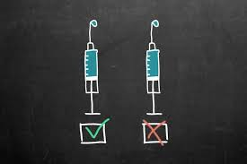
DATA OVERVIEW
Analyzed data from the 2009 National Flu vaccination Survey
The dataset comprised of responses from 26,000 individuals.
This dataset includes vaccination status, demographics, and various health-related factors.

Slide 6


Methods
I employed advanced machine learning techniques to develop predictive models. My approach involved data preprocessing, model training, and evaluation to identify the most effective algorithm for predicting vaccination behavior.

Slide 7
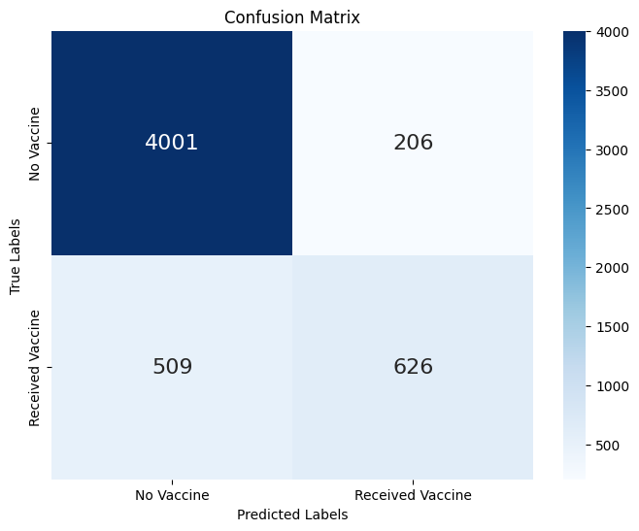
Model & Predicted Results
THE GRADIENT BOOSTING MODEL
Accuracy:
Precision:
Recall:
F1-Score:
87.0%
75.0%
55.50%
64.20%

Slide 8
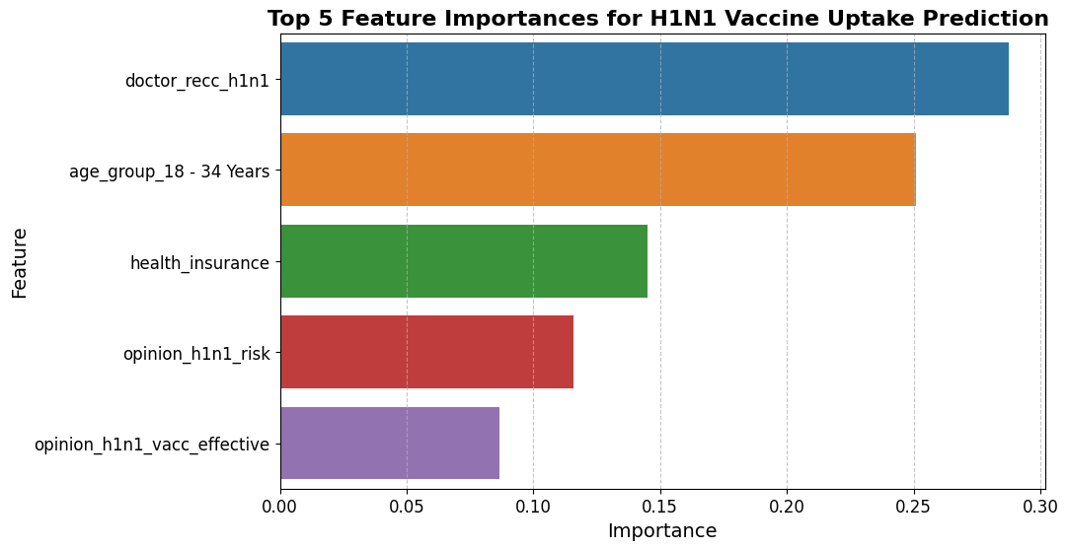
RESULTS
My analysis revealed significant insights into the factors influencing H1N1 vaccine uptake. Notably, doctor recommendations, access to healthcare, and risk perception emerged as crucial determinants of vaccination behavior.

Slide 9

Future Goals
Enhance Model Performance: We strive to continuously improve the performance of our predictive models through advanced techniques such as feature engineering and hyperparameter tuning. By refining our models, we can achieve higher accuracy and robustness in predicting vaccination behavior.
Collaborate with Stakeholders: We aim to collaborate closely with public health authorities, healthcare providers, and community organizations to implement evidence-based interventions informed by our predictive models. By working collaboratively, we can ensure that our efforts align with stakeholder priorities and effectively address vaccination challenges.

Slide 10

Connecting with Stakeholder Needs:
My findings directly address the needs of public health stakeholders by providing actionable recommendations to improve vaccination strategies. By leveraging my predictive models, stakeholders can tailor interventions to target specific demographic groups and address vaccine hesitancy effectively.

Slide 11

Conclusion:
The project offers valuable insights to enhance public health initiatives aimed at increasing vaccination coverage during flu outbreaks. By leveraging data-driven approaches, stakeholders can develop targeted interventions that resonate with the community and ultimately save lives.

Slide 12

THANK YOU

